Slide 1

Car Dekho- Used car price prediction
DEVELOPED BY
VINOOTHNA NADIKATLA

Slide 2
Objective
Imagining As a data scientist at Car Dheko, I have developed an accurate and user-friendly Streamlit-based web application for predicting the prices of used cars. This interactive tool leverages advanced machine learning algorithms and comprehensive feature engineering to provide precise car price predictions based on various input features such as brand, model, year, mileage, fuel type, and more.
The application has been deployed successfully, enabling customers and sales representatives to seamlessly evaluate resale prices and make informed decisions. It enhances the customer experience by offering a transparent pricing process and supports sales efficiency by automating price estimation. The tool has streamlined operations and contributed significantly to improving customer satisfaction and business outcomes at Car Dheko.

Slide 3
Data Processing
Data preprocessing/ Data cleaning
Import and concatenate
Imported and concatenated data using Pandas and flattened the data as structured data for all columns to get data from Dictionaries.
Missing Value Treatment
Missing values in data set treated by mean value and top value
Standardising Data Formats:
Values have been correctly formatted by removing KM, lakh, cr, Sec, mm, S in respective values
Encoding Categorical Variables:
Encoded the categorical columns by using one-hot encoding. It converts the categorical columns to binary form(0,1).
Removing Outliers:
Outliers removed from data set by dropping rows.

Slide 4
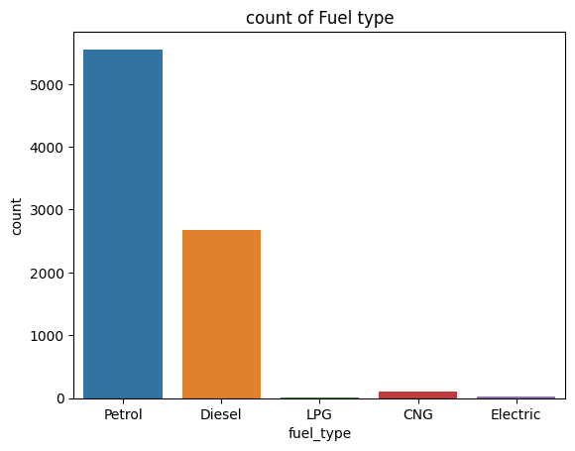
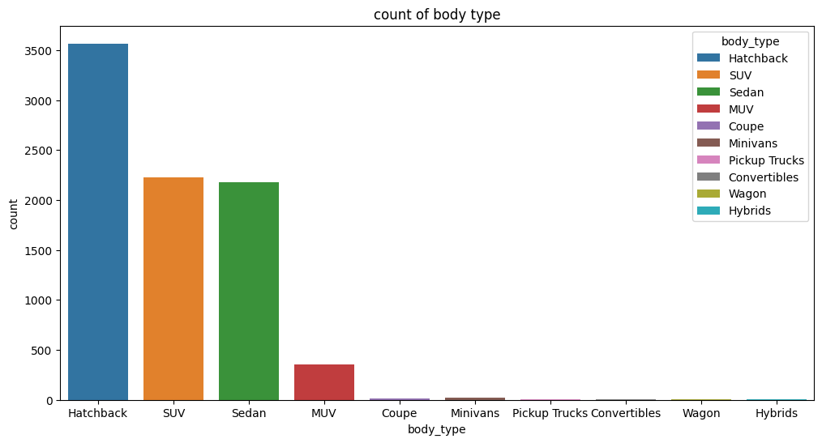
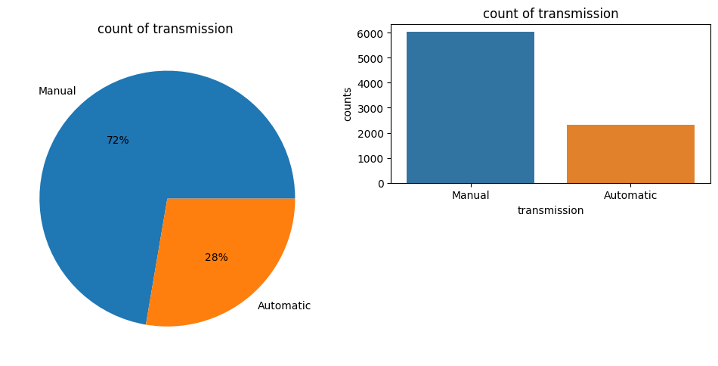
Exploratory Data Analysis (EDA)

Slide 5
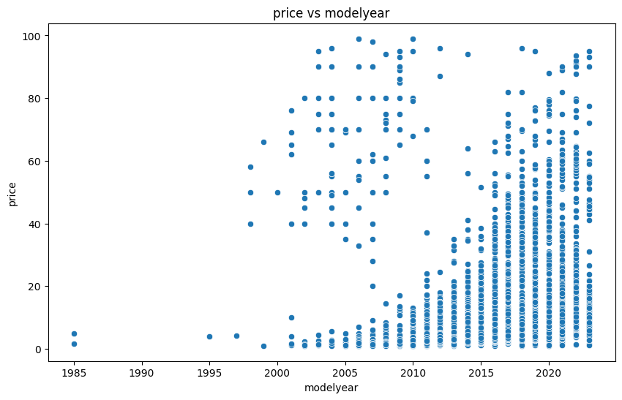

Slide 6
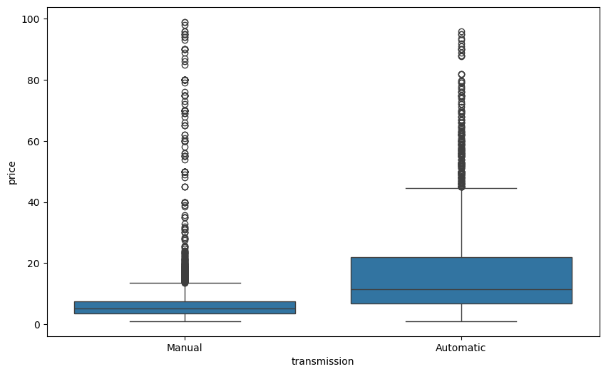

Slide 7
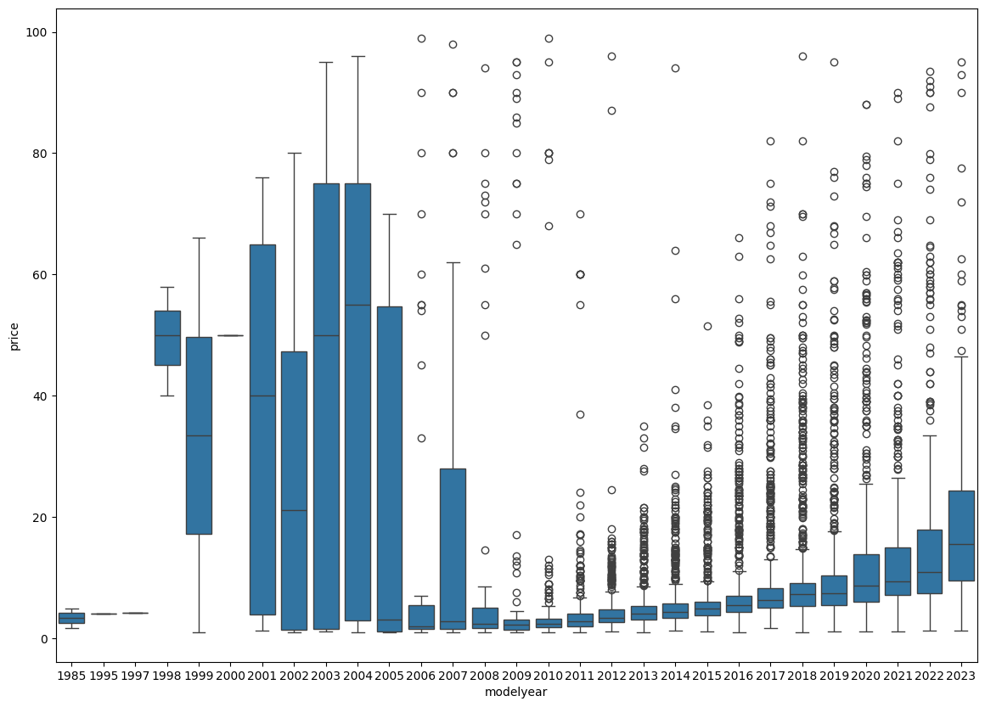

Slide 8
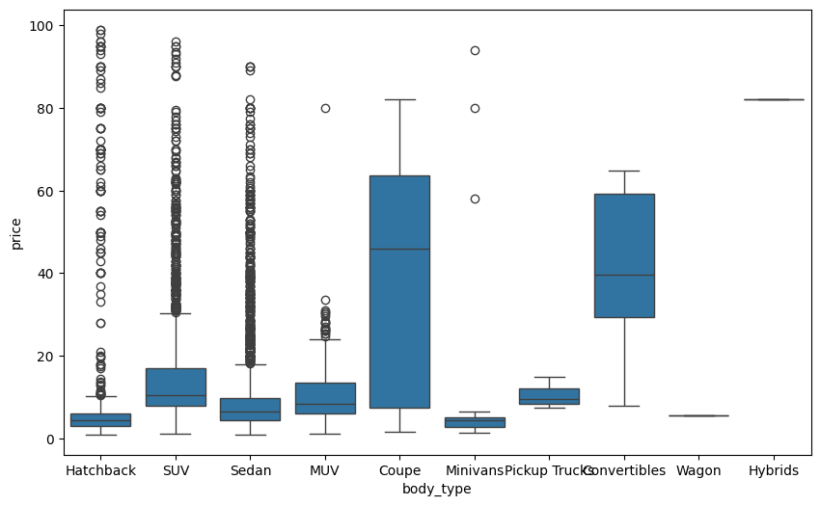

Slide 9
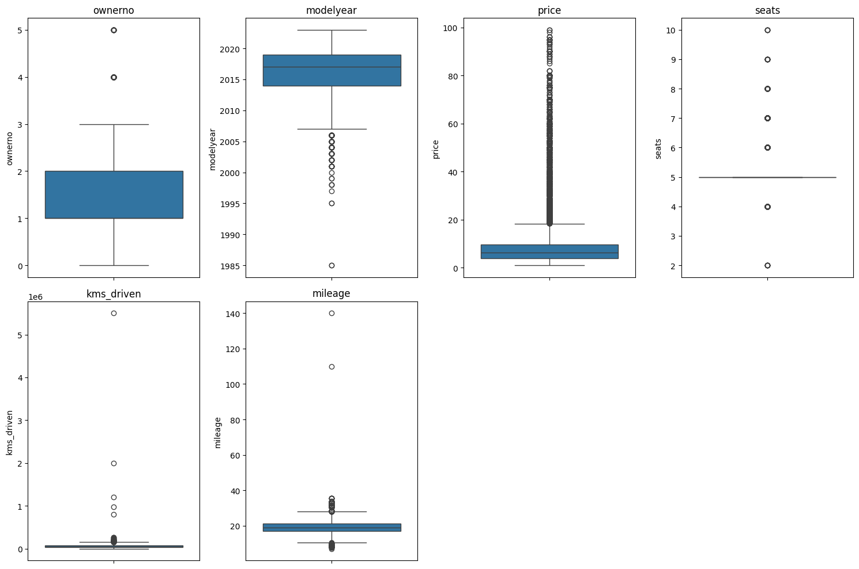
Boxplot of numerical columns before removing outlies

Slide 10
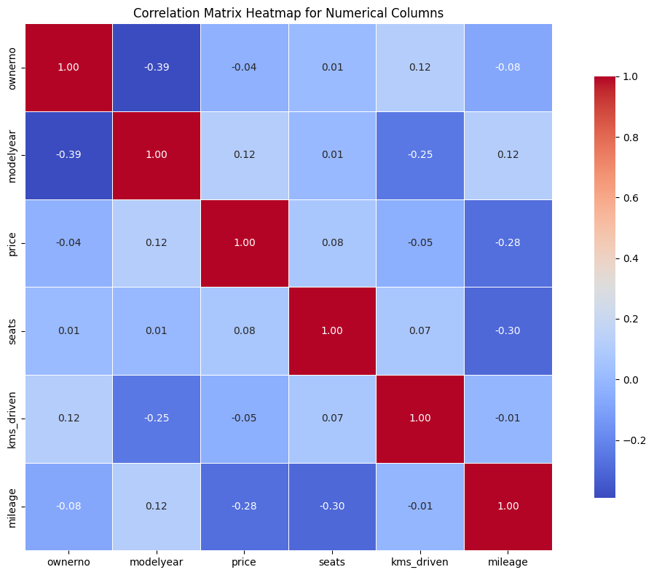

Slide 11
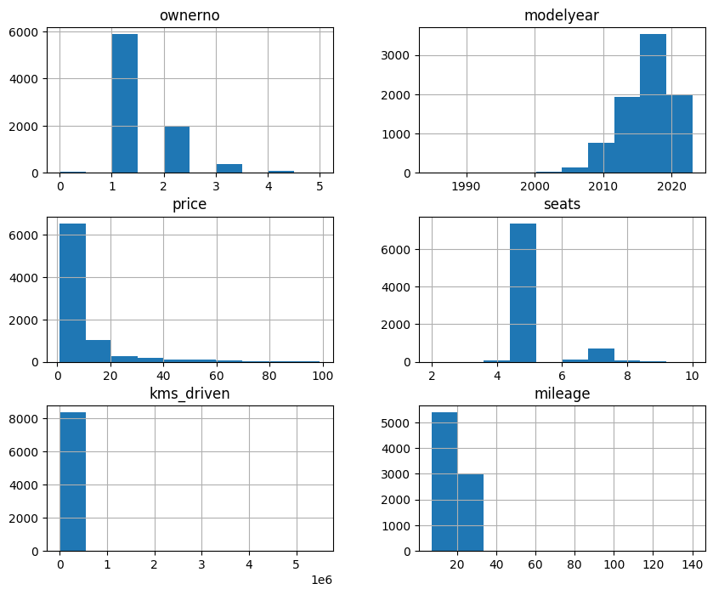

Slide 12
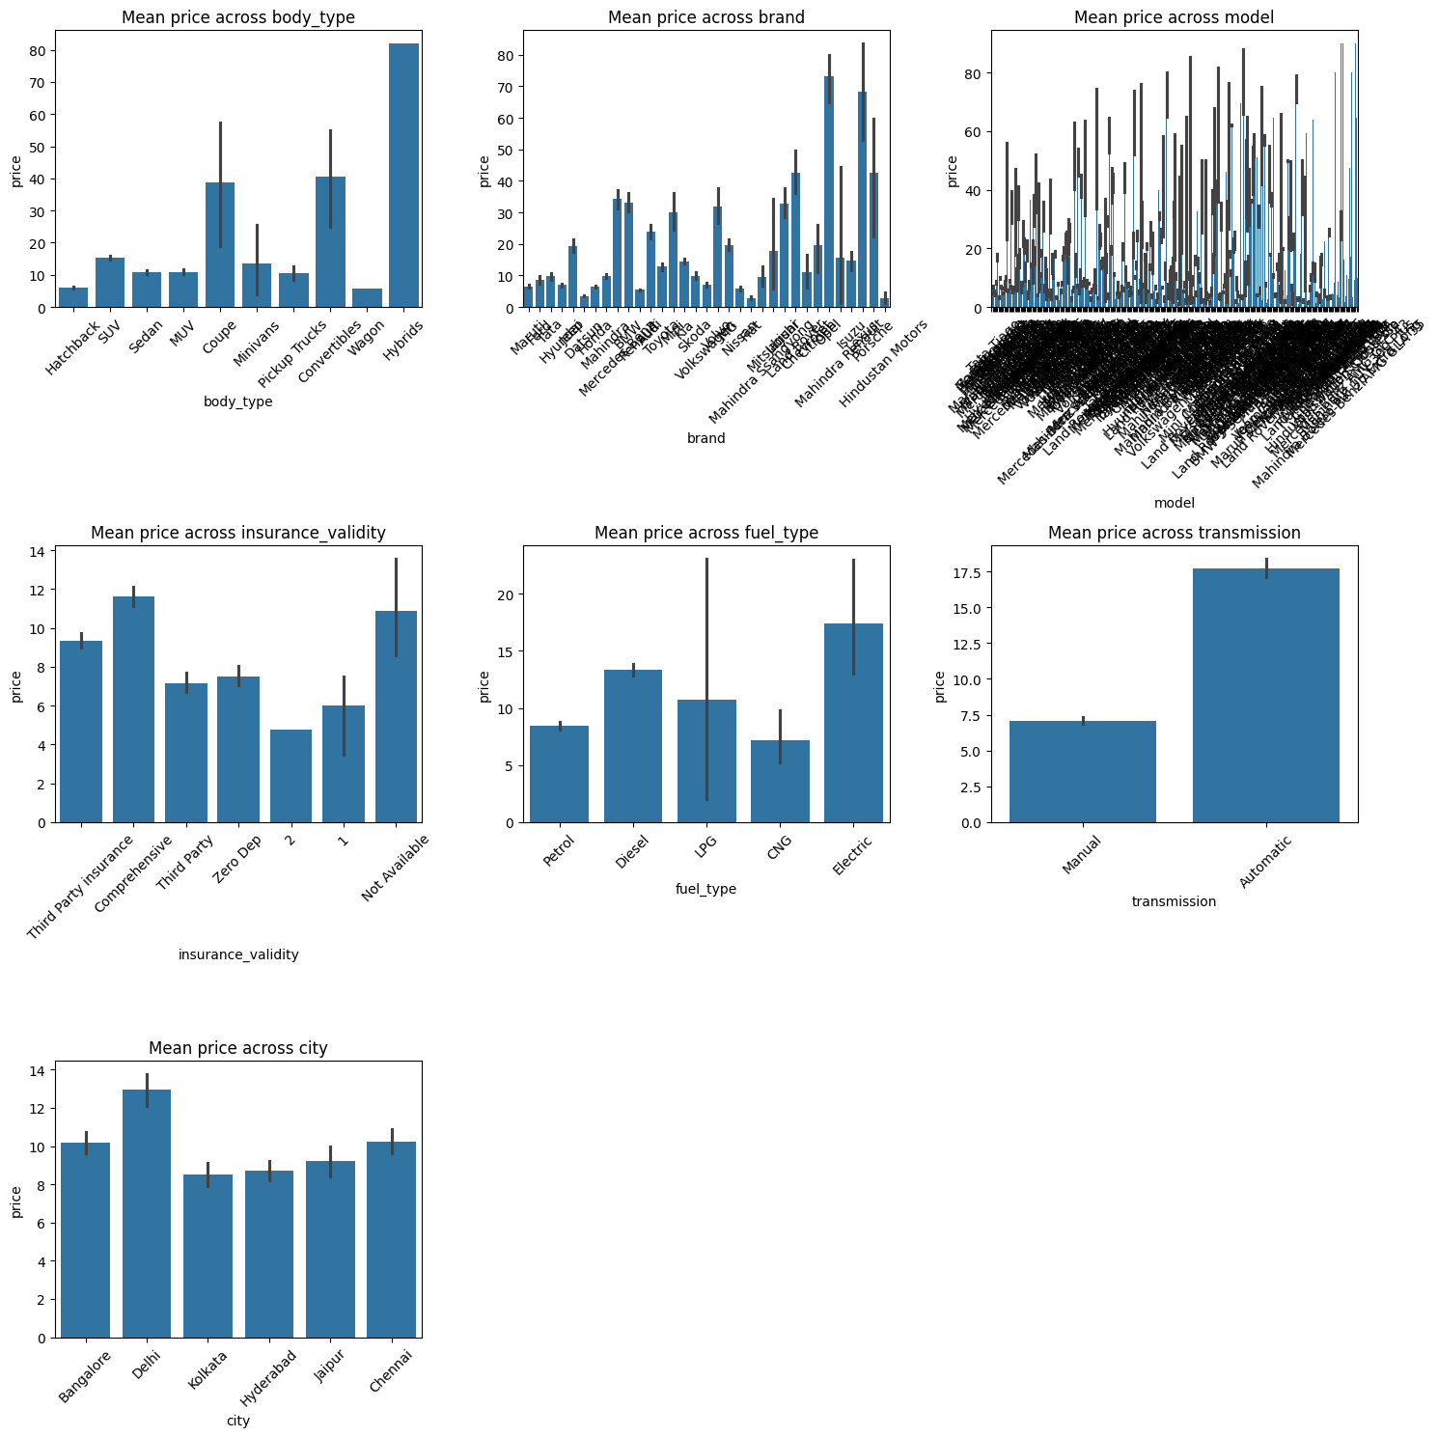

Slide 13
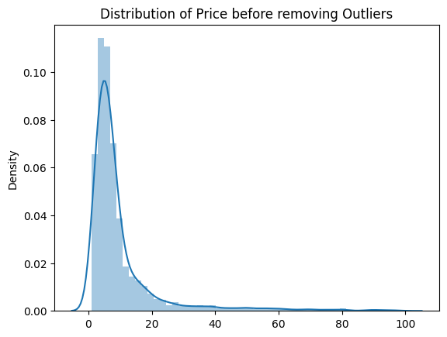
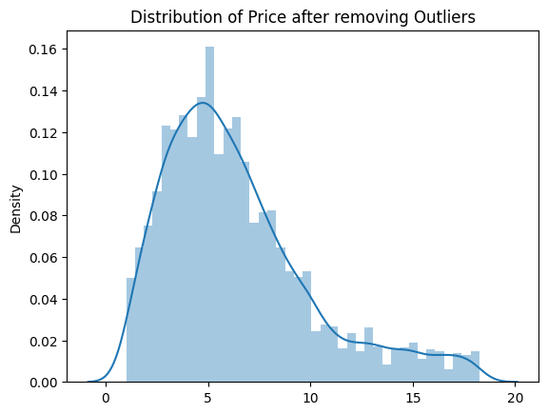
Exploratory Data Analysis (EDA)

Slide 14
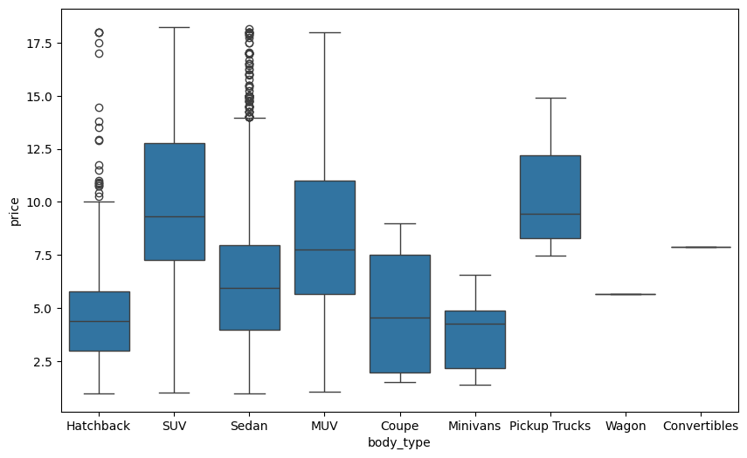
Boxplot of body type across price before removing outlies
Boxplot of body type across price After removing outlies

Slide 15
Exploratory Data Analysis (EDA)
Based on the EDA analysis Identified Outliers and removed from Data set and identified features for training.

Slide 16
Machine learning model
Model Development
After identifying Feature columns and pre-processed with one hot encoding for training process.
using Train test split method to split the data into Train and Test and started training the model.
Model Selection
1.Linear Regression
2.Decision tree Regressor
3.Random Forest Regressor
4.Gradient Boosting Algorithm

Slide 17
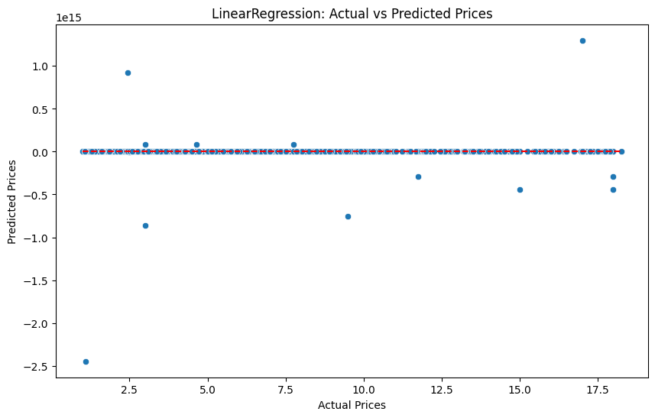
Approach
Model Training
1.Linear Regression

Slide 18
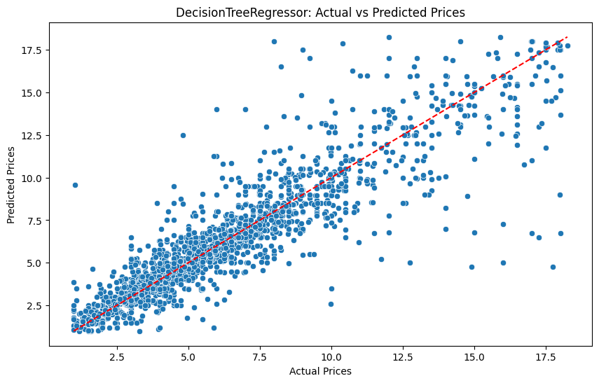
Model Training
2.Decision tree Regressor

Slide 19
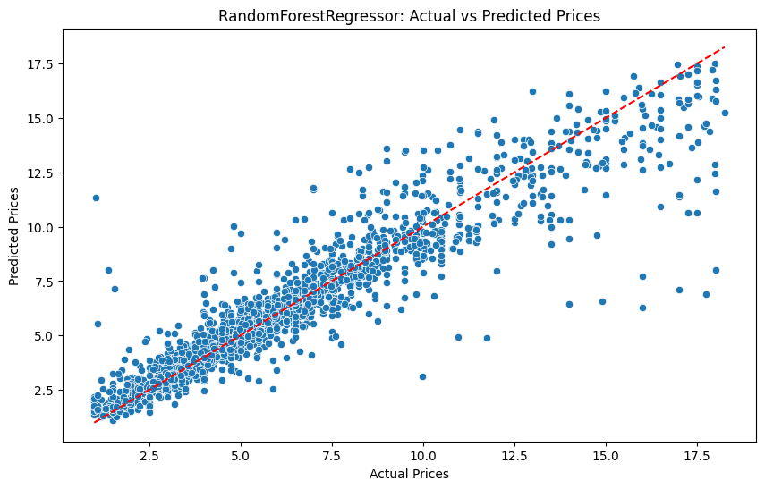
Model Training
3. Random Forest Regressor

Slide 20
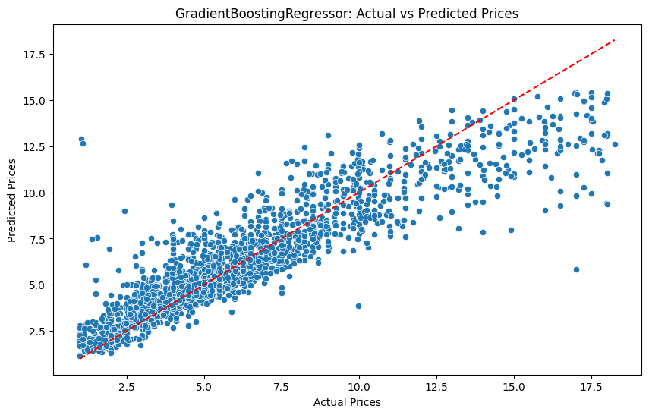
Model Training
4.Gradient Boosting Algorithm

Slide 21

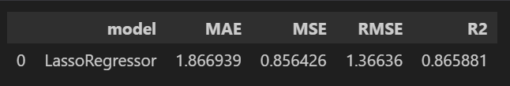
Regularization: Applying regularization techniques to prevent overfitting.
Ridge and Lasso regularization.

Slide 22
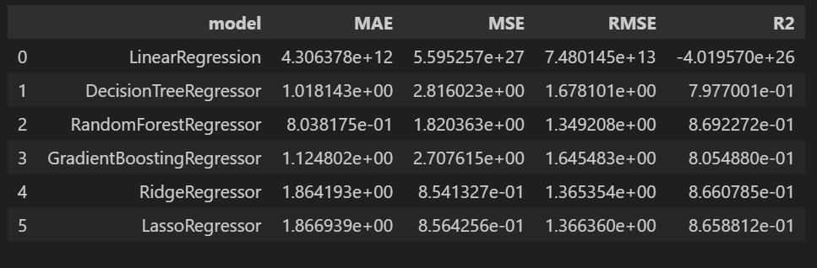
Model overview

Slide 23
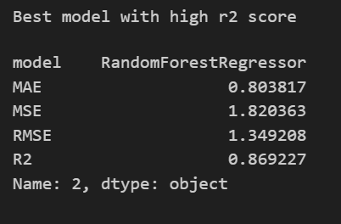
Best model with high r2 score
Hence compared to all model best model we chooses Random forest model for our prediction.

Slide 24
Model deployment in streamlit
The deployed Streamlit application is now a robust tool for predicting used car prices. It enhances customer experience, supports sales representatives in providing accurate pricing, and contributes to data-driven decision-making within Car Dheko.

Slide 25
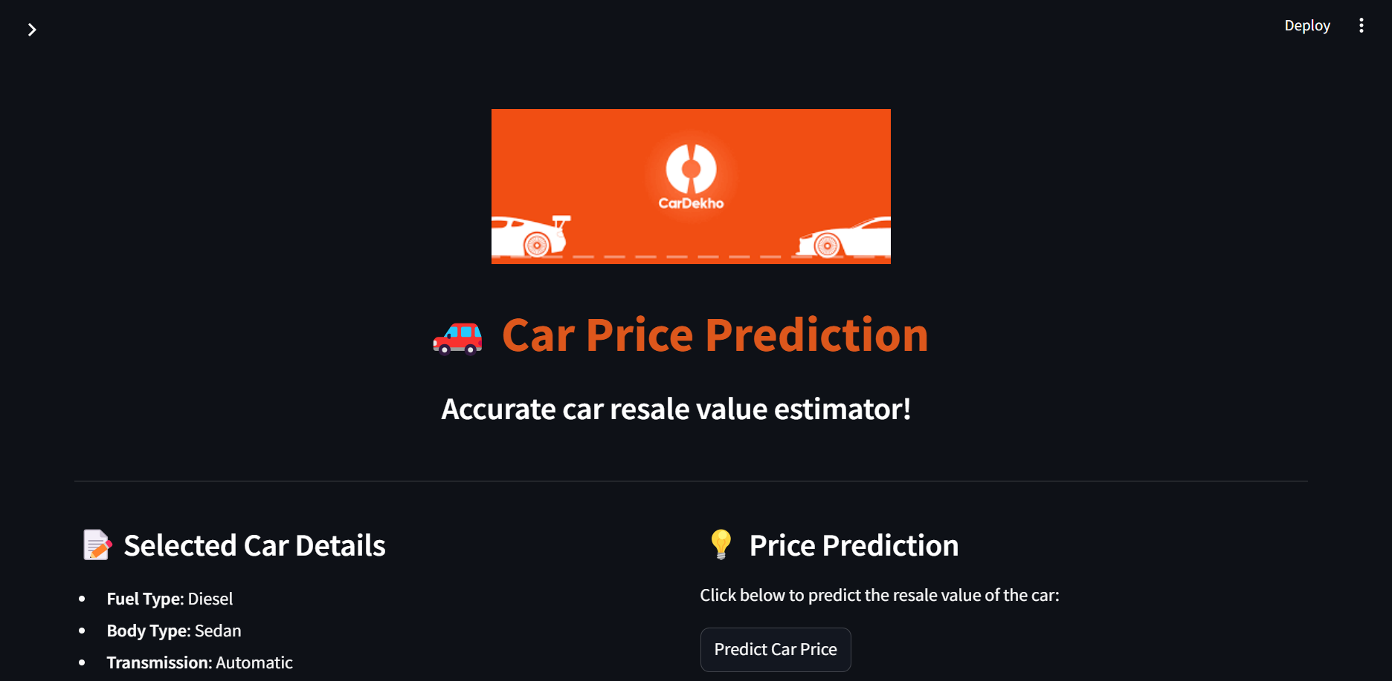
Streamlit page

Slide 26
Created a streamlit application with feature columns as input from users and predict the price for the used cars
EXAMPLE USER INPUT:
'fuel_type':'Disel',
'body_type':'Sedan',
'transmission':'Automatic',
'ownerno':3,
'brand':'BMW',
'model':'BMW 5 Series',
'modelyear':2011,
'insurance_validity': 'Third Party insurance',
'kms_driven':100000.0,
'mileage':18,
'seats':5,
'city':'hyderabad'

Slide 27
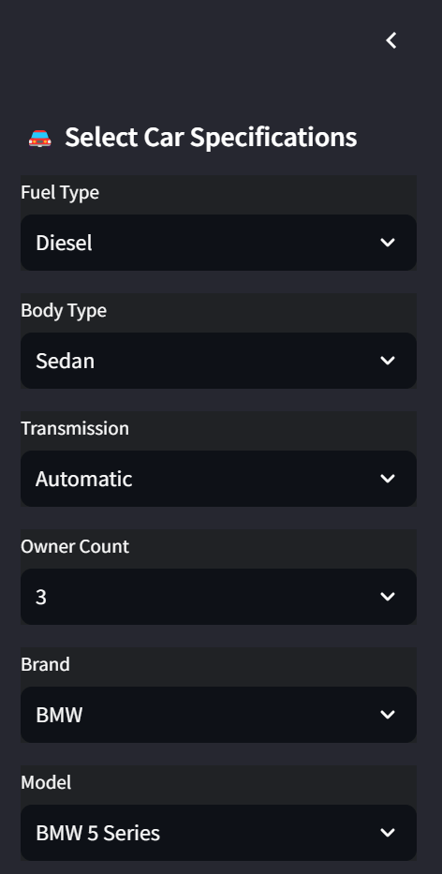
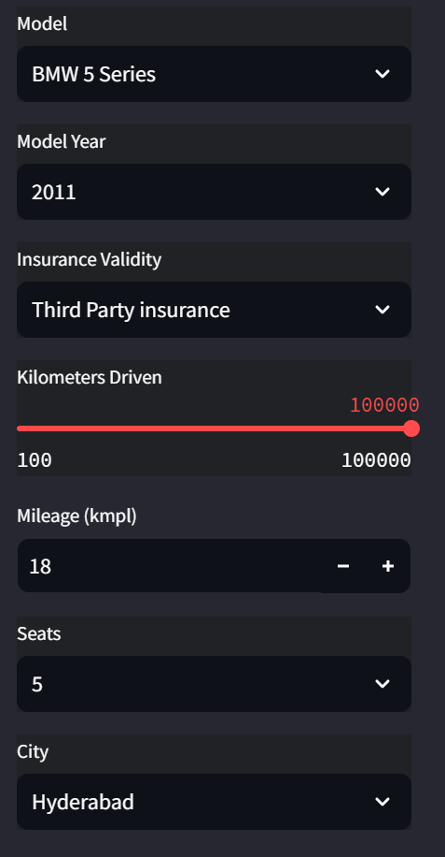
Screenshot of streamlit page whit user inputs

Slide 28
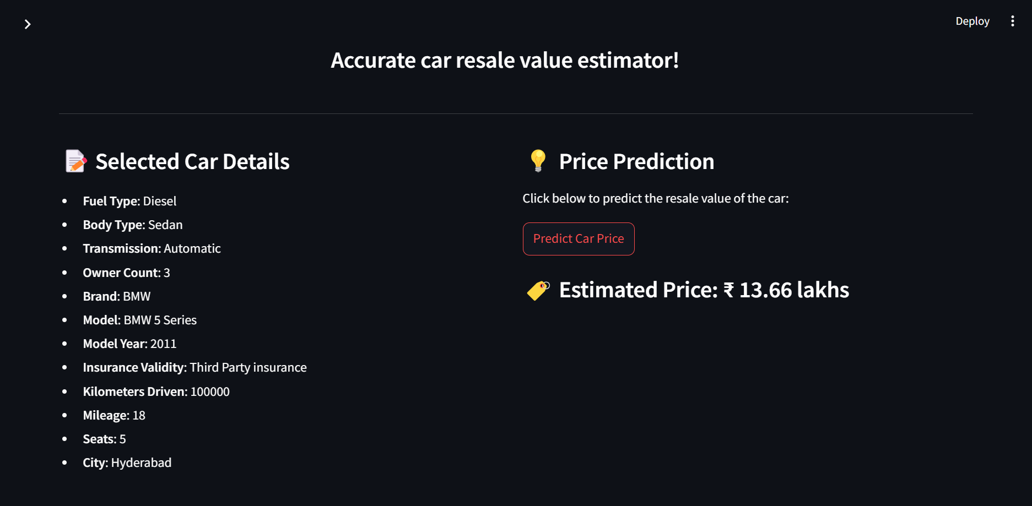
ESTIMATED PRICE

Slide 29
THANK YOU…!

